Slide 1
DISCRETE MATH DAY at WPI
Saturday, April 20 2013
WHEN DOES A CURVE BOUND A DISTORTED DISK?
Jack Graver
Syracuse University
This presentation is based on joint work with
Gerry Cargo also at Syracuse University

Slide 2
WHEN DOES A CURVE BOUND A DISTORTED DISK?
One of these curves bounds a distorted disk, one bounds two distinct distorted disk and one bounds no disk at all.

Slide 3
By an immersion we mean a local homeomorphism f:
Each point p in the image has
a finite number of preimages
p₁, p₂,…, p_{k}.
Each point p in the image has a neighborhood N and the preimages have disjoint neighborhoods N₁, N₂,…, N_{k} so that f maps N_{i} into N and f restricted to N_{i} is a homeomorphism.

Slide 4
Let C denote the unit circle in R² and D the unit disk. We consider two questions:
Question 1: Can an immersion of C into R² be extended to an immersion of D?
Question 2: If such an extension exists, is it unique up to homotopy?
We will restrict our attention to immersions with at least one crossing and with only simple crossings:

Slide 5
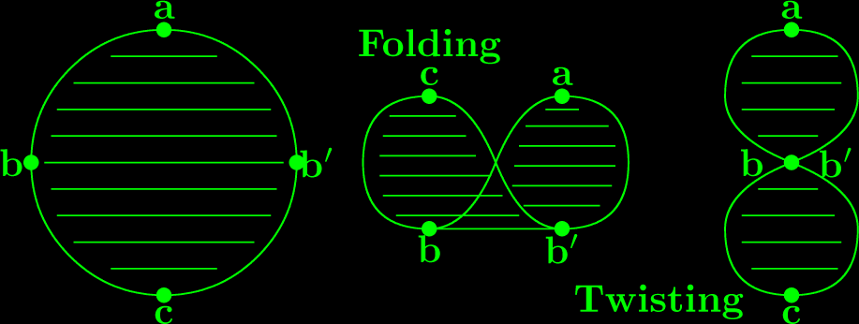
An immersion of the circle C can always be extended to a continuous function from D into R². The condition that the extension be an immersion of the disk (a distorted disk) precludes ``folding" and ``twisting”

Slide 6
There are two published solutions to the existence question:
C. J. Titus, The combinatorial topology of analytic functions on the boundary of a disk, Acta Math. 106 (1961), 45-64.
S. J. Blank, Extending immersions of the circle, Ph. D. Dissertation, Brandeis Univ. (1967).
Both approaches are inductive: add a segment to cut the curve into two curves extend each of these and glue the extensions together.
Neither considered the uniqueness question.

Slide 7
My involvement with this problem concerned the uniqueness question. It arose naturally in an investigation of graphene fragments by Guo, Hansen, and Zheng.
One way that a graphene fragment can be pictured is as a connected, finite union of closed hexagons in the hexagonal tessellation of the plane.

Slide 8
The clockwise cyclic sequence of R’s (right turns) and L’s (left turns), the boundary code, uniquely determines the boundary of the such a fragment and, in this case, the fragment itself:

Slide 9
To visualize a general graphene fragment think of constructing it in space by gluing together hexagonal tiles edgewise. As the fragment is being constructed, it may eventually turn around and build underneath itself.
Such a fragment projects onto a region of the hexagonal tessellation of the plane that overlaps itself with a self-intersecting boundary. In that case, does the boundary code still uniquely determine the fragment?

Slide 10
Guo, Hansen & Zheng answered this question in the negative. They produced the simplest example of two non-isomorphic graphene fragments with the same boundary code.
This is a smoothed version of the boundary of their example:
The GHZ-curve:
Their question is
topological rather
than combinatorial.
However, the solution to this
topological problem is actually combinatorial.

Slide 11
We will visualize an immersed curve as a patch:
a plane graph without its outside face.
The patches that come from immersed curve are regular of degree 4.
Hence given such a patch P=(V,E,F) we have
4|V|=2|E| or
|E|=2|V|.
By Euler’s formula |V|-|E|+|F|=1, we have
|V|-2|V|+|F|=1 or
|F|= |V|+1.

Slide 12
Think of traversing the circle C and its image counterclockwise and label C as pictured:
We will show that, in any extension to D, points b, c, d and e must have additional preimages in the interior of D.

Slide 13
By properly counting the number of times we cross the curve as we move inward, we can deduce the number of preimages of each face, (edge and vertex) in any extension:

Slide 14
If an extension exists the preimages of these vertices, edges and faces form a covering patch:

Slide 15
Assume P=(V,E,F) is the patch of an immersed curve. For each face φ, λετ δ(φ) denote the degree of that face and λετ μ(φ) denote the multiplicity of that faces.
Suppose that P admits a covering patch
P=(V,E,F). We can check to be sure that P
satisfies Euler’s formula.
We have: |F|= Sum_{(f in F)} m(f)
In our example: 1+1+1+1+2+2+3=11

Slide 16
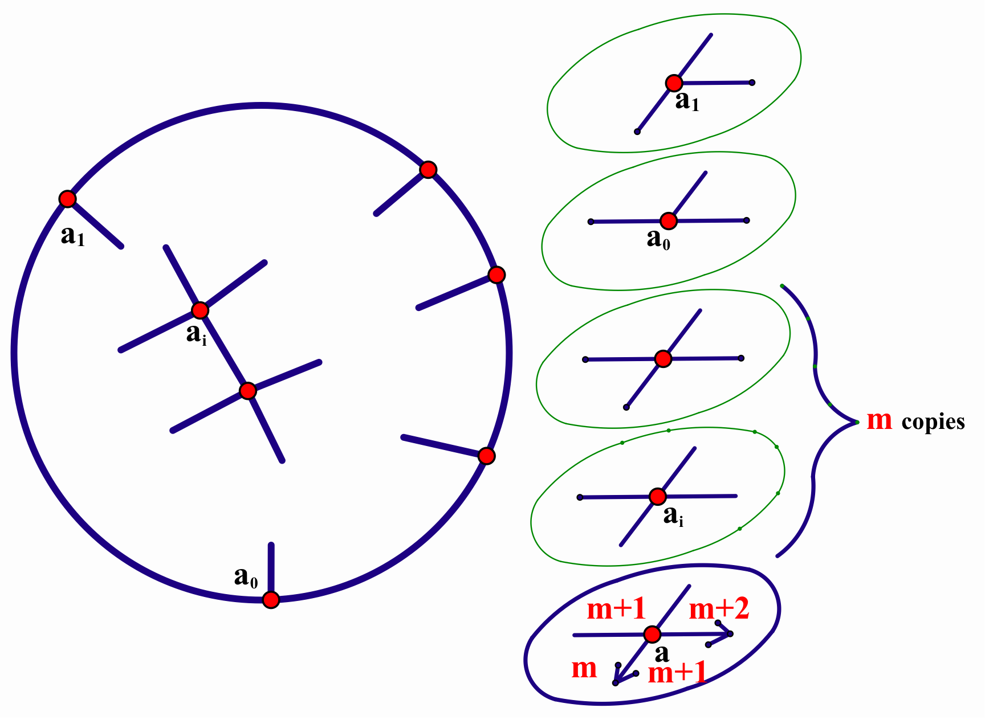
Sum_{(f in F)} m(f)d(f)+(2|V|) = 2|E|;
Sum_{(f in F)} m(f)d(f)+2(2|V|) = 4|V|.

Slide 17
Substituting 4|F|=4(Sum_{(f in F)} m(f)),
4|E| = 2(Sum_{(f in F)} m(f)d(f))+4|V| and
4|V| = Sum_{(f in F)} m(f)d(f)+4|V|
into 4 x Euler’s formula 4|V|- 4|E|+ 4|F|= 4
yields the necessary “Euler Constraint” for an immersion of C into R² to have an extension to an immersion of D into R²:
The Euler Sum
M(P,m)=Sum_{(f in F)} m(f)[4-d(f)]
must equal 4.

Slide 18
1(4-3)+1(4-3)+1(4-1)+1(4-1)+2(4-5)+2(4-5)+3(4-4)
= 1 + 1 + 3 + 3 + (-2) + (-2) + 0 = 4

Slide 19
The Euler Constraint and the condition that the multiplicities are all non negative are necessary.
Unfortunately, they are not sufficient.
Research problem:
Find additional condition(s) for a set of
conditions that are both necessary and
sufficient for the existence of an extension.

Slide 20
However, if all of the multiplicities are non-negative and the Euler constraint is satisfied, one may attempt to construct an extension.
The construction proceeds in stages:
First, compute the multiplicities of the
vertices and construct their preimages.

Slide 21
The multiplicity of a vertex or edge will be the multiplicity of the incident face of largest multiplicity. Here x₀ is red, x₁, blue x₂, green.

Slide 22
Second, starting with the outside faces, construct the preimages of the edges so that they bound the preimages of faces:

Slide 23
Lifting the right hand faces of multiplicities 1 & 2.
The two options here lead to the two different extensions of the circle immersion to the entire disk.

Slide 24
The two distinct extensions are:

Slide 25
Consider an immersion of the unit circle C into the sphere S². Can it be extended to an immersion of D into S²? If such an extension exists, is it unique up to homotopy?
For example, consider the
curve pictured here on the
sphere. Since there is no
“outside,” we consider
the graph G=(V,E,F)
determined by the
curve. Of course, If an
extension exists, it will still
be a patch.

Slide 26
There are two problems:
Since there is no “outside” for G, there is no obvious way to direct
this curve.
Since the image of the
disk can completely
cover the sphere any
number of times there is no obvious
way to assign multiplicities to the faces of G.

Slide 27
We can arbitrarily select a direction
and a face with multiplicity 0
and then complete the
assignment of multiplicities:
Then, if there is a face with negative
multiplicity, we may add a constant
to all of the multiplicities so that all
multiplicities are non negative and
at least one is 0. We call these
multiplicities the base multiplicities
that that direction:

Slide 28
Reversing direction, negating multiplicity and adding the gap (largest – smallest multiplicity) gives the base multiplicities for the reverse direction:
gap =2

Slide 29
Starting with the base multiplicities and repeatedly increasing all multiplicities by 1 results in all possible multiplicity assignments to for that direction:
M(G,m₀)= -4 M(G,m₁)= 4 M(G,m₂)= 12
We can then compute the Euler Sum for each assignment of multiplicities and conclude that only with multiplicities m₁ (among these) could G be extended.

Slide 30
Let G=(V,E,F) be the graph of a curve on the sphere; Let h₀ denote the base multiplicities for one direction and k₀ the base multiplicities for the other direction. We will compute a simple formula for the Euler Sum for an arbitrary set of multiplicities. But first, we need to compute
Sum_{(f in F)} [4-d(f)] = 4|F|-Sum_{(f in F)} d(f)
= 4|F|- 2|E|
Since every vertex has degree 4, 4|V|= 2|E|.
Therefore, -2|E|+ 4|V|= 0. Adding this to the right side above and invoking Euler’s Formula gives
Sum_{(f in F)} [4-d(f)] = 4|F|- 4|E|+ 4|V|= 8

Slide 31
Now consider multiplicities m obtained by adding p to all of the multiplicities in h₀:
M(G,m) = Sum_{(f in F)} (h₀(f)+p)[4-d(f)]
= M(G, h₀) + pxSum_{(f in F)} [4-d(f)]
= M(G, h₀) + 8p.
We also can compute the multiplicities for k₀:
M(G,k₀) = Sum_{(f in F)} (g-h₀(f))[4-d(f)]
= 8g - M(G, h₀),
where g is the gap.

Slide 32
It follows from these formulas that, for any curve, at most one direction with one set of multiplicities can satisfy the Euler Condition:
From M(G,m) = M(G, h₀) + 8p, we conclude that, for each of the two orientations of the graph, at most one of the possible multiplicities can satisfy the Euler Condition.
From M(G,k₀) + M(G, h₀) = 8g > 16, we conclude that one of M(G,k₀) and M(G, h₀) is already greater than 4 and therefore none of the multiplicities for the graph of the curve with that direction can satisfy the Euler Condition.

Slide 33
As we saw, our curve with
the pictured multiplicities does
satisfy the Euler Condition. To
actually construct an extension,
we proceed as in the planar case,
starting with the faces having the smallest
multiplicities and work “inward.”
This graph with these multiplicities has two non-homotopic extensions.

Slide 34
The template

Slide 35
In 1941, Atkisson and MacLane wrote a paper in which they proved that the sequence of crossings determines the drawing of the curve on the sphere. That is, the sequence a₀c₀e₁e₀d₁a₁f₀d₀b₁b₀c₁f₁ completely determines the patch of the GHZ-curve:
Start by drawing the crossings
And then connect them up by the code

Slide 37
This means that this sequence
a₀c₀e₁e₀d₁a₁f₀d₀b₁b₀c₁f₁
determines EVERYTHING!
If we could DECODE it, it would answer both questions:
Question 1: Can this immersion of C into R² be extended to an immersion of D?
Question 2: If such an extension exists, is it unique up to homotopy? If not, how many different extensions are there?

Slide 38
Second research problem:
Decode the boundary sequence!

Slide 39
I can decode the gap:

Slide 40
Gap 2 decoded
We can also identify the faces of multiplicity 2. Their vertices all have subscript 0; if x₀ is followed by y₁, y₀ is the next vertex around the face of multiplicity 2.

Slide 41
We can try to construct the lifted faces above these faces of multiplicity 2:
The rim edges are blue; the red edges are forced. Hence, if there is an extension, its unique.
Taking a closer look, on the left the lifted edges form two circuits and can bound two faces. But on the right we have just one circuit of length 6 double covering the boundary of the degree face twice: a face of odd degree can’t be lifted!

Slide 42
THEOREM. Let f be the immersion of the circle C into R². Then:
(1) If the indices in the code alternate and the faces of multiplicity two all have even degree, then f extends to an emersion of D and that extension is unique.
(2) If the indices in the code alternate and there is a face of multiplicity two of odd degree, then f has no extension to an emersion of D.

